Slide 1

Linear Regression
Presentation By
Aravind Reddy

Slide 2
Introduction to Machine learning
Machine learning is a field of study that enables computers to learn and make predictions or decisions without being explicitly programmed. It has gained significant popularity due to its ability to uncover patterns, make sense of complex data, and provide valuable insights.
One fundamental concept in machine learning is regression, which involves predicting a continuous target variable based on the values of one or more input variables. Linear regression is a simple yet powerful technique used for regression tasks. It assumes a linear relationship between the input variables and the target variable.
Linear regression is widely used in various domains, including finance, economics, healthcare, social sciences, and many others. It helps us understand how different factors contribute to an outcome and provides a quantitative understanding of relationships.
In this presentation, we will delve into the concepts and techniques of linear regression. We will explore both simple and multiple linear regression, discuss the assumptions involved, and explore methods for model evaluation and interpretation.

Slide 3
Agenda
Correlation Analysis
Simple Linear Regression
Cost Function
Gradient Descent
Assumptions of Linear Regression
Evaluation metrics for regression analysis
F-test for significance
T-test
Multiple Linear Regression
Introduction to Linear Regression

Slide 4
Correlation Analysis

Slide 5
Correlation Analysis
Correlation analysis is used to measure strength of the association (linear relationship) between two variables:
Only concerned with strength of the relationship
No causal effect is implied
A scatter plot (or scatter diagram) is used to show the relationship between two variables

Slide 6
Scatter Plot Examples
(continued)
Moderate relationships
Strong relationships
y
y
x
x
Weak relationships
y
y
x
x

Slide 7
Scatter Plot Examples
Linear relationships
Curvilinear relationships
y
y
x
x
y
y
x
x

Slide 8
Scatter Plot Examples
(continued)
No relationship
y
y
x
x

Slide 9
Correlation Coefficient
The population correlation coefficient ρ (rho) measures the strength of the association between the variables
The sample correlation coefficient r is an estimate of ρ and is used to measure the strength of the linear relationship in the sample observations

Slide 10
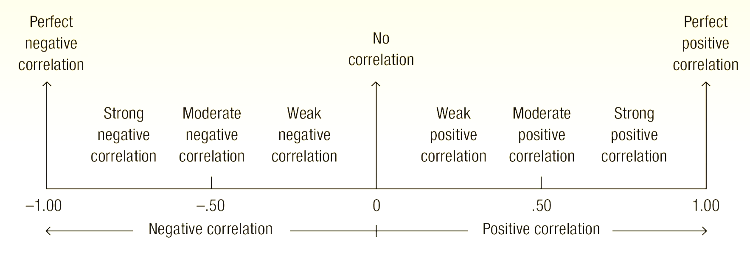
Features of ρ and r
Unit free and range between -1 and 1
The closer to -1, the stronger the negative linear relationship
The closer to 1, the stronger the positive linear relationship
The closer to 0, the weaker the linear relationship

Slide 11
Examples of Approximate r Values
y
r = -1
y
r = - 0.6
y
r = 0
x
x
x
r = +0.3
y
y
r = +1
x
x

Slide 12
Calculating the Correlation Coefficient
Sample correlation coefficient:
or the algebraic equivalent:
where:
r = Sample correlation coefficient
n = Sample size
x = Value of the independent variable
y = Value of the dependent variable

Slide 13
Example:
A real estate agent wishes to examine the relationship between the selling price of a home and its size (measured in square feet)
Y = house price in $1000s
X = square feet
Scatter Plot

Slide 14
Example:
(continued)
Y | X | XY | X² | Y²
245 | 1400 | 343000 | 1960000 | 60025
312 | 1600 | 499200 | 2560000 | 97344
279 | 1700 | 474300 | 2890000 | 77841
308 | 1875 | 577500 | 3515625 | 94864
199 | 1100 | 218900 | 1210000 | 39601
219 | 1550 | 339450 | 2402500 | 47961
405 | 2350 | 951750 | 5522500 | 164025
324 | 2450 | 793800 | 6002500 | 104976
319 | 1425 | 454575 | 2030625 | 101761
255 | 1700 | 433500 | 2890000 | 65025
2865 | 17150 | 5085975 | 30983750 | 853423
Total
r = 0.7621

Slide 15
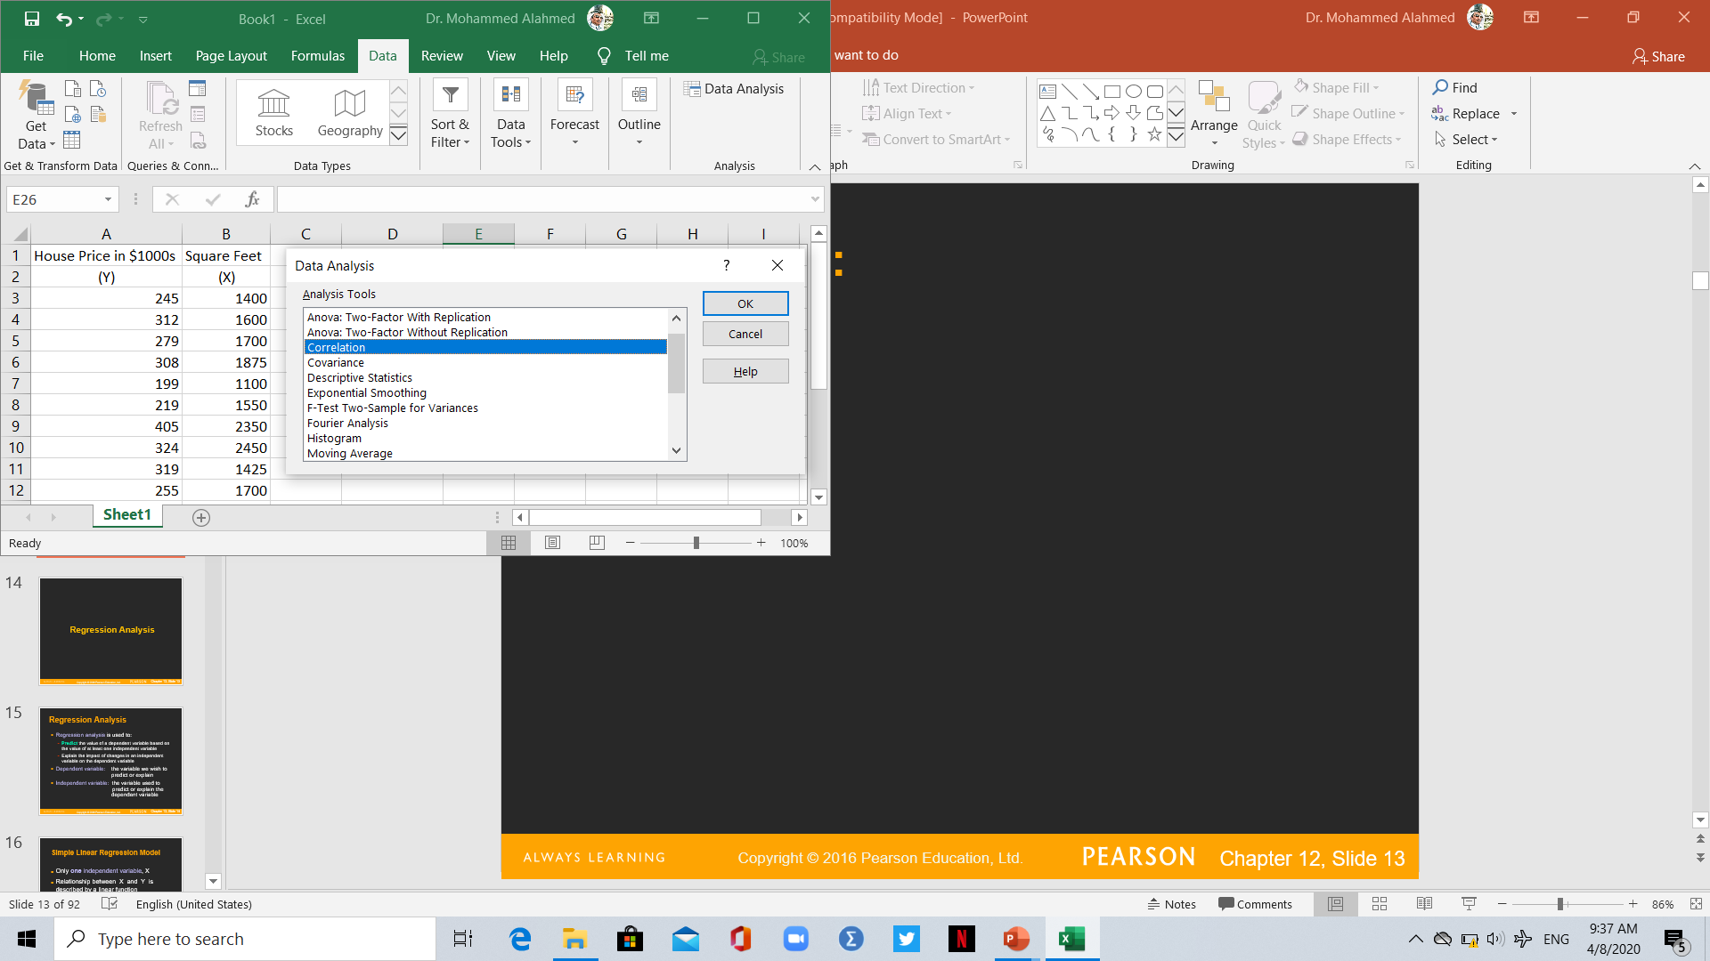
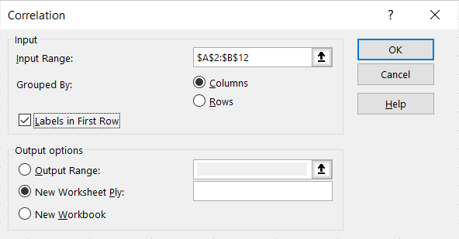
Using Excel:
(continued)
Conclusion: there is a relatively strong positive linear relationship between house price and its size
 | House Price in $1000s | Square Feet
House Price in $1000s | 1
Square Feet | 0.76 | 1

Slide 16
What is Linear Regression?
Linear regression is a statistical technique used to model the relationship between a dependent variable and one or more independent variables. It assumes a linear relationship between the input variables and the target variable.
In linear regression, we aim to find the best-fitting line that represents the relationship between the independent variables (often denoted as x) and the dependent variable (often denoted as y). The line is defined by an equation of the form:
y = mx + c
Where:
y is the dependent variable (the target variable we want to predict)
x is the independent variable(s) (the input variable(s))
m is the slope of the line, representing the change in y with respect to a unit change in x
c is the y-intercept, indicating the value of y when x is 0

Slide 17
Regression Analysis
Regression analysis is used to:
Predict the value of a dependent variable based on the value of at least one independent variable
Explain the impact of changes in an independent variable on the dependent variable
Dependent variable: the variable we wish to
predict or explain
Independent variable: the variable used to predict or explain the dependent variable

Slide 18
Simple Linear Regression Model
Only one independent variable, X
Relationship between X and Y is described by a linear function
Changes in Y are assumed to be related to changes in X

Slide 19
Simple Linear Regression Model
Population Regression Line:
Population Slope Coefficient
Random Error term
Population Y intercept
Independent Variable
Dependent Variable
Linear component
Random Error
component

Slide 20
Simple Linear Regression Model
(continued)
Y
Observed Value of Y for X_{i}
ε_{i}
Slope = β₁
Predicted Value of Y for X_{i}
Random Error for this X_{i} value
Intercept = β₀
X_{i}
X

Slide 21
Simple Linear Regression Equation (Prediction Line)
The simple linear regression equation provides an estimate of the population regression line
Estimated (or predicted) Y value for observation i
Estimate of the regression intercept
Estimate of the regression slope
Value of X for observation i

Slide 22
The Least Squares Method
b₀ and b₁ are obtained by finding the values that minimize the sum of the squared differences between Y and Y :
∧

Slide 23
Finding the Least Squares Equation
The coefficients b₀ and b₁, and other regression results in this chapter, will be found using Excel or by the following equations:
or

Slide 24
Interpretation of the Slope and the Intercept
b₀ is the estimated mean value of Y when the value of X is zero
b₁ is the estimated change in the mean value of Y as a result of a one-unit increase in X

Slide 25

Example
A real estate agent wishes to examine the relationship between the selling price of a home and its size (measured in square feet) and to predict home price.
A random sample of 10 houses is selected
Dependent variable (Y) = house price in $1000s
Independent variable (X) = square feet

Slide 26
Example: Data
(continued)
House Price in $1000s (Y) | Square Feet (X)
245 | 1400
312 | 1600
279 | 1700
308 | 1875
199 | 1100
219 | 1550
405 | 2350
324 | 2450
319 | 1425
255 | 1700
Scatter Plot

Slide 27
Example:
(continued)
Y | X | XY | X²
245 | 1400 | 343000 | 1960000
312 | 1600 | 499200 | 2560000
279 | 1700 | 474300 | 2890000
308 | 1875 | 577500 | 3515625
199 | 1100 | 218900 | 1210000
219 | 1550 | 339450 | 2402500
405 | 2350 | 951750 | 5522500
324 | 2450 | 793800 | 6002500
319 | 1425 | 454575 | 2030625
255 | 1700 | 433500 | 2890000
2865 | 17150 | 5085975 | 30983750
b₁ = 0.10977
b₀ = 98.248

Slide 28
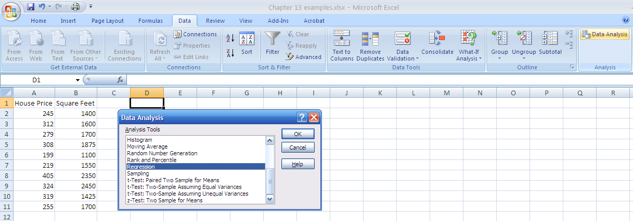
Example: Using Excel
(continued)
1. Choose Data
2. Choose Data Analysis
3. Choose Regression

Slide 29
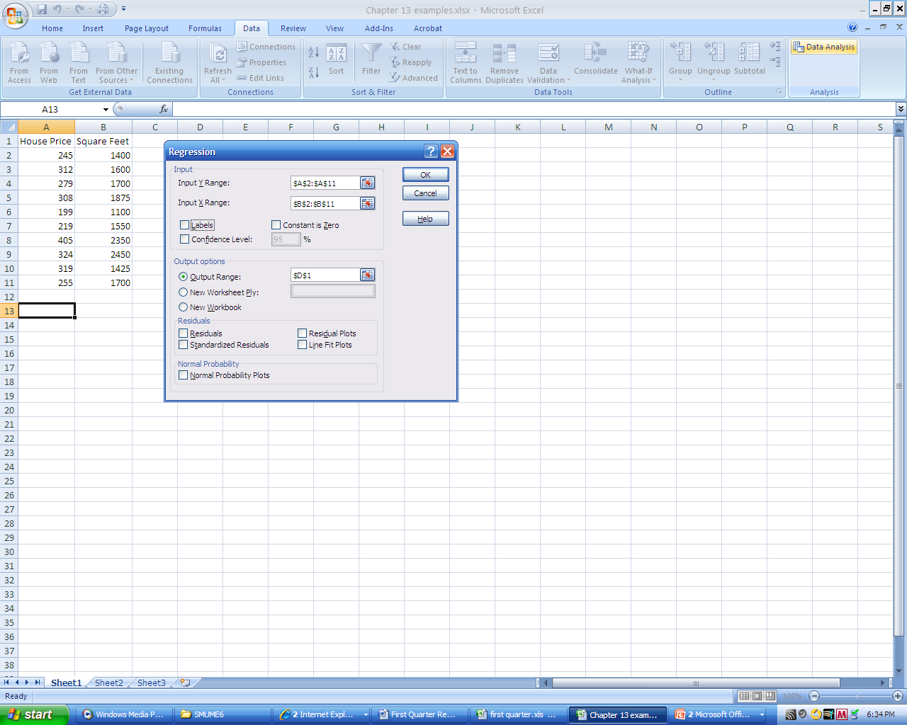
Example: Using Excel
(continued)
Enter Y range and X range and desired options

Slide 30
Example: Excel Output
(continued)
Regression Statistics
Multiple R | 0.76211
R Square | 0.58082
Adjusted R Square | 0.52842
Standard Error | 41.33032
Observations | 10
ANOVA | df | SS | MS | F | Significance F
Regression | 1 | 18934.9348 | 18934.9348 | 11.0848 | 0.01039
Residual | 8 | 13665.5652 | 1708.1957
Total | 9 | 32600.5000
 | Coefficients | Standard Error | t Stat | P-value | Lower 95% | Upper 95%
Intercept | 98.24833 | 58.03348 | 1.69296 | 0.12892 | -35.57720 | 232.07386
Square Feet | 0.10977 | 0.03297 | 3.32938 | 0.01039 | 0.03374 | 0.18580
The regression equation is:

Slide 31
Example: Graphical Representation
Slope
= 0.10977
Intercept
= 98.248

Slide 32
Example: Interpretation of b_{o}
b₀ is the estimated mean value of Y when the value of X is zero (if X = 0 is in the range of observed X values)
Because a house cannot have a square footage of 0, b₀ has no practical application

Slide 33
Example: Interpreting b₁
b₁ estimates the change in the mean value of Y as a result of a one-unit increase in X
Here, b₁ = 0.10977 tells us that the mean value of a house increases by .10977($1000) = $109.77, on average, for each additional one square foot of size

Slide 34
Example: Making Predictions
Predict the price for a house with 2000 square feet:
The predicted price for a house with 2000 square feet is 317.85($1,000s) = $317,850

Slide 35
Assumptions of linear Regression
The basic assumptions of Linear Regression are as follows:
1. Linearity: It states that the dependent variable Y should be linearly related to independent variables. This assumption can be checked by plotting a scatter plot between both variables.

Slide 36
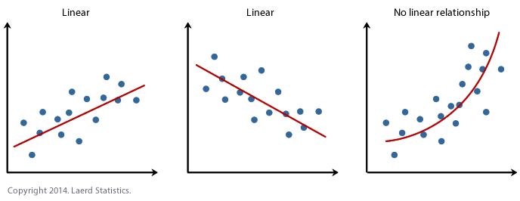
Assumptions of linear Regression

Slide 37
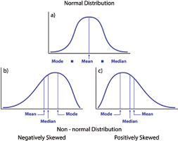
Assumptions of linear Regression
2. Normality: The X and Y variables should be normally distributed. Histograms, KDE plots, Q-Q plots can be used to check the Normality assumption.

Slide 38
Assumptions of linear Regression
Homoscedasticity: The variance of the error terms should be constant i.e the spread of residuals should be constant for all values of X. This assumption can be checked by plotting a residual plot. If the assumption is violated then the points will form a funnel shape otherwise they will be constant.

Slide 39
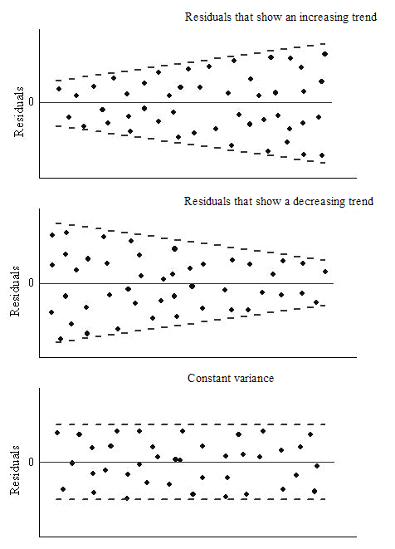
Assumptions of linear Regression

Slide 40
Assumptions of linear Regression
Independence/No Multicollinearity: The variables should be independent of each other i.e no correlation should be there between the independent variables. To check the assumption, we can use a correlation matrix or VIF score. If the VIF score is greater than 5 then the variables are highly correlated.

Slide 41
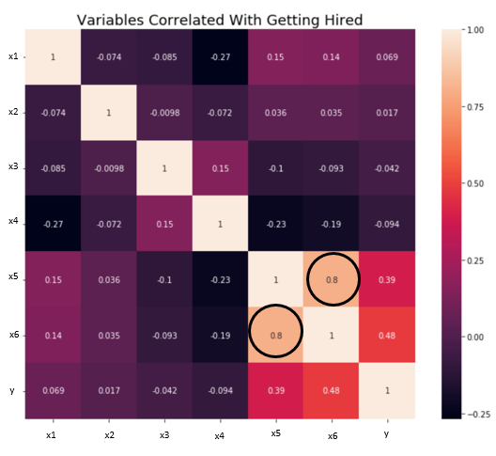
Assumptions of linear Regression
In the image, a high correlation is present between x5 and x6 variables.

Slide 42
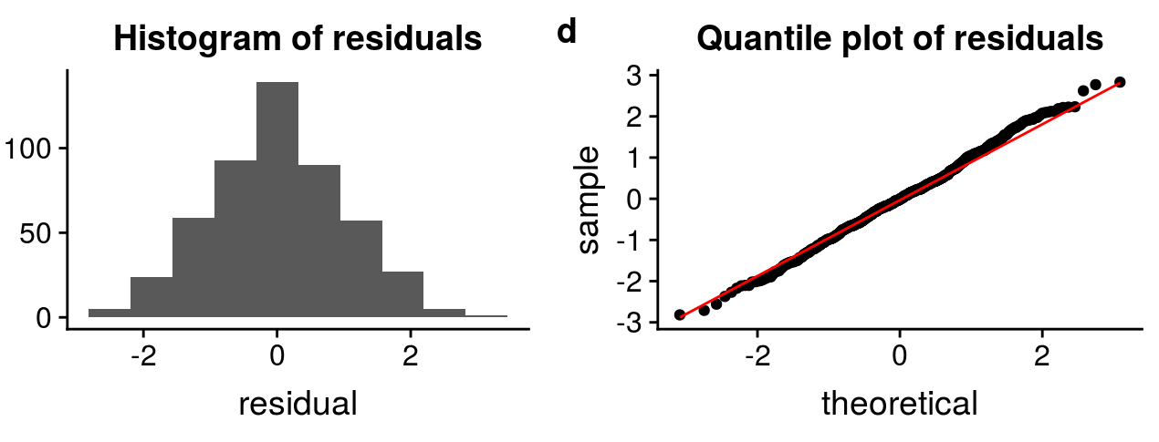
Assumptions of linear Regression
he error terms should be normally distributed. Q-Q plots and Histograms can be used to check the distribution of error terms.

Slide 43
How to deal with the Violation of any of the Assumption
The Violation of the assumptions leads to a decrease in the accuracy of the model therefore the predictions are not accurate and error is also high.
For example, if the Independence assumption is violated then the relationship between the independent and dependent variable can not be determined precisely.

Slide 44
How to deal with the Violation of any of the Assumption
The Violation of the assumptions leads to a decrease in the accuracy of the model therefore the predictions are not accurate and error is also high.
For example, if the Independence assumption is violated then the relationship between the independent and dependent variable can not be determined precisely.

Slide 45
Example: Making Predictions
(continued)
When using a regression model for prediction, only predict within the relevant range of data
Relevant range for interpolation
Do not try to extrapolate beyond the range of observed X’s

Slide 46
Cost Function
In linear regression, a cost function is used to quantify the overall difference between the predicted values and the actual values of the dependent variable. The goal is to find the values of the slope (m) and y-intercept (c) that minimize this difference and provide the best-fitting line.
The most commonly used cost function for linear regression is the mean squared error (MSE). It is calculated by taking the average of the squared differences between the predicted values and the actual values:

Slide 47
Cost Function
In linear regression, a cost function is used to quantify the overall difference between the predicted values and the actual values of the dependent variable. The goal is to find the values of the slope (m) and y-intercept (c) that minimize this difference and provide the best-fitting line.
The most commonly used cost function for linear regression is the mean squared error (MSE). It is calculated by taking the average of the squared differences between the predicted values and the actual values:
MSE = (1/n) * Σ(yᵢ - ŷᵢ)²
Where:
n is the number of data points
yᵢ is the actual value of the dependent variable for the i-th data point
ŷᵢ is the predicted value of the dependent variable for the i-th data point
The squared differences are used to penalize larger errors more heavily, as squaring amplifies the differences. By averaging the squared differences across all data points, the MSE provides a measure of how well the line fits the data.

Slide 48
Cost Function
The goal of linear regression is to minimize the MSE, which means finding the values of m and c that result in the smallest possible average squared difference between the predicted and actual values.
To achieve this, optimization algorithms like gradient descent are commonly used. These algorithms iteratively adjust the values of m and c to find the optimal values that minimize the cost function.
By minimizing the MSE, we obtain the line that best fits the data and represents the relationship between the independent and dependent variables. This line can then be used for making predictions on new instances.

Slide 49
Gradient Descent
Gradient descent is an optimization algorithm commonly used in linear regression to find the optimal values of the slope (m) and y-intercept (c) that minimize the cost function, such as the mean squared error (MSE).
The key idea behind gradient descent is to iteratively update the values of m and c by taking steps proportional to the negative gradient of the cost function. The negative gradient points in the direction of steepest descent, allowing us to move closer to the minimum of the cost function.

Slide 50
Gradient Descent
Gradient descent is an optimization algorithm commonly used in linear regression to find the optimal values of the slope (m) and y-intercept (c) that minimize the cost function, such as the mean squared error (MSE).
The key idea behind gradient descent is to iteratively update the values of m and c by taking steps proportional to the negative gradient of the cost function. The negative gradient points in the direction of steepest descent, allowing us to move closer to the minimum of the cost function.
The update equations for gradient descent in linear regression are as follows:
m_new = m_old - learning_rate * (∂MSE/∂m)
c_new = c_old - learning_rate * (∂MSE/∂c)
Where:
m_old and c_old are the current values of the slope and y-intercept
m_new and c_new are the updated values after each iteration
learning_rate is a hyperparameter that determines the step size for each update
(∂MSE/∂m) and (∂MSE/∂c) are the partial derivatives of the MSE with respect to m and c, respectively

Slide 51
Gradient descent
The partial derivatives represent the rate of change of the MSE with respect to the slope and y-intercept. They indicate the direction in which the parameters should be updated to minimize the cost function.
In each iteration of gradient descent, the updated values of m and c move closer to the optimal values that minimize the cost function. The learning rate controls the size of the steps taken during each update. Choosing an appropriate learning rate is crucial, as a too large value may result in overshooting the minimum, while a too small value may slow down the convergence.
By iteratively updating the parameters using gradient descent, we can find the optimal values of m and c that result in the best-fitting line for the given data. This line represents the linear regression model that can be used for making predictions on new instances.

Slide 52
Evaluation Metrics for Regression Analysis
To understand the performance of the Regression model performing model evaluation is necessary. Some of the Evaluation metrics used for Regression analysis are:
R squared or Coefficient of Determination:
Adjusted R squared
Mean Squared Error (MSE)
Root Mean Squared Error (RMSE)

Slide 53
Measures of Variation
Total variation is made up of two parts:
Total Sum of Squares
Regression Sum of Squares
Error Sum of Squares
where:
= Mean value of the dependent variable
Y_{i} = Observed value of the dependent variable
= Predicted value of Y for the given X_{i} value

Slide 54
Measures of Variation
SST = total sum of squares (Total Variation)
Measures the variation of the Y_{i} values around their mean Y
SSR = regression sum of squares (Explained Variation)
Variation attributable to the relationship between X and Y
SSE = error sum of squares (Unexplained Variation)
Variation in Y attributable to factors other than X

Slide 55
Measures of Variation
(continued)
Y
Y_{i}
∧
∧
SSE = ∑(Y_{i} - Y_{i} )²
Y
_
SST = ∑(Y_{i} - Y)²
∧
Y
_
∧
_
SSR = ∑(Y_{i} - Y)²
_
Y
Y
X
X_{i}

Slide 56
Coefficient of Determination, r²
The coefficient of determination is the portion of the total variation in the dependent variable that is explained by variation in the independent variable
The coefficient of determination is also called r-square and is denoted as r²
note:

Slide 57
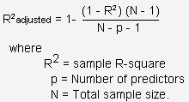
Adjusted R Square
It is the improvement to R squared. The problem/drawback with R2 is that as the features increase, the value of R2 also increases which gives the illusion of a good model. So the Adjusted R2 solves the drawback of R2. It only considers the features which are important for the model and shows the real improvement of the model. Adjusted R2 is always lower than R2.

Slide 58
Examples of Approximate r² Values
(continued)
Y
r² = 1
Perfect linear relationship between X and Y:
100% of the variation in Y is explained by variation in X
X
Y
r² = 1
X

Slide 59
Examples of Approximate r² Values
(continued)
Y
0 < r² < 1
Weaker linear relationships between X and Y:
Some but not all of the variation in Y is explained by variation in X
X
Y
X

Slide 60
Examples of Approximate r² Values
(continued)
Y
r² = 0
No linear relationship between X and Y:
The value of Y does not depend on X. (None of the variation in Y is explained by variation in X)
X

Slide 61
Example: Coefficient of Determination, r² in Excel
Regression Statistics
Multiple R | 0.76211
R Square | 0.58082
Adjusted R Square | 0.52842
Standard Error | 41.33032
Observations | 10
ANOVA | df | SS | MS | F | Significance F
Regression | 1 | 18934.9348 | 18934.9348 | 11.0848 | 0.01039
Residual | 8 | 13665.5652 | 1708.1957
Total | 9 | 32600.5000
 | Coefficients | Standard Error | t Stat | P-value | Lower 95% | Upper 95%
Intercept | 98.24833 | 58.03348 | 1.69296 | 0.12892 | -35.57720 | 232.07386
Square Feet | 0.10977 | 0.03297 | 3.32938 | 0.01039 | 0.03374 | 0.18580
58.08% of the variation in house prices is explained by variation in square feet

Slide 62
Standard Error of Estimate
The Standard Error of Estimate is the measure of variation of an observation made around the computed regression line. Simply, it is used to check the accuracy of predictions made with the regression line.
The standard deviation of the variation of observations around the regression line is estimated by
Where
SSE = error sum of squares
n = sample size

Slide 63
Comparing Standard Errors
The smaller the value of a standard error of estimate the closer are the dots to the regression line and better is the estimate based on the equation of the line
Y
Y
X
X
The magnitude of S_{YX} should always be judged relative to the size of the Y values in the sample data
i.e., S_{YX} = $41.33K is moderately small relative to house prices in the $200K - $400K range

Slide 64
Example: Standard Error of Estimate in Excel
Regression Statistics
Multiple R | 0.76211
R Square | 0.58082
Adjusted R Square | 0.52842
Standard Error | 41.33032
Observations | 10
ANOVA | df | SS | MS | F | Significance F
Regression | 1 | 18934.9348 | 18934.9348 | 11.0848 | 0.01039
Residual | 8 | 13665.5652 | 1708.1957
Total | 9 | 32600.5000
 | Coefficients | Standard Error | t Stat | P-value | Lower 95% | Upper 95%
Intercept | 98.24833 | 58.03348 | 1.69296 | 0.12892 | -35.57720 | 232.07386
Square Feet | 0.10977 | 0.03297 | 3.32938 | 0.01039 | 0.03374 | 0.18580

Slide 65
F-Test for Significance
The F-test of overall significance indicates whether your linear regression model provides a better fit to the data
F Test statistic:
where F_{STAT} follows an F distribution with k numerator and (n – k - 1) denominator degrees of freedom
(k = the number of independent variables in the regression model)

Slide 66
F-Test for Significance: Excel Output
Regression Statistics
Multiple R | 0.76211
R Square | 0.58082
Adjusted R Square | 0.52842
Standard Error | 41.33032
Observations | 10
ANOVA | df | SS | MS | F | Significance F
Regression | 1 | 18934.9348 | 18934.9348 | 11.0848 | 0.01039
Residual | 8 | 13665.5652 | 1708.1957
Total | 9 | 32600.5000
With 1 and 8 degrees of freedom
p-value for the F-Test

Slide 67
F Test for Significance
(continued)
Test Statistic:
Decision:
Conclusion:
H₀: β = 0
H₁: β ≠ 0
α = 0.05
df₁= 1 df₂ = 8
Critical Value:
F_{α} = 5.32
Reject H₀ at α = 0.05
α = .05
There is sufficient evidence that house size affects selling price
0
F
Do not
reject H₀
Reject H₀
F_{.05} = 5.32

Slide 68
Inferences About the Slope
The standard error of the regression slope coefficient (b₁) is estimated by
where:
= Estimate of the standard error of the slope
= Standard error of the estimate

Slide 69
Inferences About the Slope: t-test
t-test for a population slope
Is there a linear relationship between X and Y?
Null and alternative hypotheses
H₀: β₁ = 0 (no linear relationship)
H₁: β₁ ≠ 0 (linear relationship does exist)
Test statistic
where:
b₁ = regression slope
coefficient
β₁ = hypothesized slope
S_{b1} = standard
error of the slope

Slide 70
Inferences About the Slope: t-test Example
Estimated Regression Equation:
House Price in $1000s (y) | Square Feet (x)
245 | 1400
312 | 1600
279 | 1700
308 | 1875
199 | 1100
219 | 1550
405 | 2350
324 | 2450
319 | 1425
255 | 1700
house price = 98.25 + 0.1098 (sq. ft.)
The slope of this model is 0.1098
Is there a relationship between the square footage of the house and its sales price?

Slide 71
Inferences About the Slope: t Test Example
From Excel output:
 | Coefficients | Standard Error | t Stat | P-value
Intercept | 98.24833 | 58.03348 | 1.69296 | 0.12892
Square Feet | 0.10977 | 0.03297 | 3.32938 | 0.01039
H₀: β₁ = 0
H₁: β₁ ≠ 0
b₁

Slide 72
Inferences About the Slope: t Test Example using the critical value
H₀: β₁ = 0
H₁: β₁ ≠ 0
Test Statistic: t_{STAT} = 3.329
d.f. = 10- 2 = 8
Decision: Reject H₀
α/2=.025
α/2=.025
There is sufficient evidence that square footage affects house price
Reject H₀
Do not reject H₀
Reject H₀
-t_{α/2}
t_{α/2}
0
-2.3060
2.3060
3.329

Slide 73
Inferences About the Slope: t Test Example using p-value
From Excel output:
 | Coefficients | Standard Error | t Stat | P-value
Intercept | 98.24833 | 58.03348 | 1.69296 | 0.12892
Square Feet | 0.10977 | 0.03297 | 3.32938 | 0.01039
Decision: Reject H₀, since p-value < α
α = 0.05
There is sufficient evidence that square footage affects house price.

Slide 74
Confidence Interval Estimate for the Slope
Confidence Interval Estimate of the Slope:
d.f. = n - 2
Excel Printout for House Prices:
 | Coefficients | Standard Error | t Stat | P-value | Lower 95% | Upper 95%
Intercept | 98.24833 | 58.03348 | 1.69296 | 0.12892 | -35.57720 | 232.07386
Square Feet | 0.10977 | 0.03297 | 3.32938 | 0.01039 | 0.03374 | 0.18580
At 95% level of confidence, the confidence interval for the slope is (0.0337, 0.1858)

Slide 75
Confidence Interval Estimate for the Slope
(continued)
Since the units of the house price variable is $1000s, we are 95% confident that the average impact on sales price is between $33.74 and $185.80 per square foot of house size
This 95% confidence interval does not include 0.
Conclusion: There is a significant relationship between house price and square feet at the .05 level of significance

Slide 76
Multiple Linear Regression
In simple linear regression, we considered the relationship between a dependent variable and a single independent variable. However, in many real-world scenarios, multiple factors may influence the target variable simultaneously. This is where multiple linear regression comes into play.
Multiple linear regression extends the concept of linear regression to include multiple independent variables. The equation for multiple linear regression can be represented as:
y = b0 + b1x1 + b2x2 + ... + bnxn

Slide 77
Multiple Linear Regression
Where:
y is the dependent variable (the target variable we want to predict)
x1, x2, ..., xn are the independent variables (the input variables)
b0 is the y-intercept, indicating the value of y when all the independent variables are zero
b1, b2, ..., bn are the coefficients (slopes), representing the change in y with respect to a unit change in each independent variable

Slide 78
In multiple linear regression, each independent variable has its own coefficient that indicates its impact on the dependent variable while holding other variables constant. These coefficients can be positive, negative, or zero, depending on the nature and strength of the relationship.
The multiple linear regression model aims to estimate the optimal values of the coefficients that minimize the overall difference between the predicted values and the actual values of the dependent variable, like simple linear regression.
By incorporating multiple independent variables, we can capture more complex relationships and make more nuanced predictions. However, it is important to ensure that the assumptions of linear regression, such as linearity and independence, hold for each independent variable.

Slide 79
Example of Multiple Linear Regression
To illustrate the concept of multiple linear regression, let's consider an example where we want to predict the price of a house based on multiple factors such as area, number of bedrooms, and location. We have collected data for multiple houses, recording the respective prices (dependent variable, y) along with the corresponding values of the independent variables (x1 = area, x2 = number of bedrooms, x3 = location).
In this example, we aim to build a multiple linear regression model that can predict the price of a house based on these factors.

Slide 80
Here's an example table for the multiple linear regression example of predicting house prices based on area, number of bedrooms, and location:
House | Area (x1) | Bedrooms (x2) | Location (x3) | Price (y)
1 | 1500 | 3 | A | $300,000
2 | 1800 | 4 | B | $350,000
3 | 1200 | 2 | C | $250,000
4 | 2000 | 3 | B | $400,000
5 | 1600 | 3 | C | $320,000
6 | 1400 | 2 | A | $280,000
7 | 1800 | 4 | C | $380,000
8 | 2100 | 3 | A | $420,000

Slide 81
In this example, we have a dataset of 8 houses. Each house has its respective area, number of bedrooms, location, and price. The area, number of bedrooms, and location are considered as independent variables (x1, x2, and x3), while the price is the dependent variable (y).
The goal of multiple linear regression is to estimate the optimal values of the coefficients (b0, b1, b2, and b3) in the regression equation:
y = b0 + b1x1 + b2x2 + b3x3
By fitting the multiple linear regression model to this data, we can predict the price of a house based on its area, number of bedrooms, and location.
For example, given a new house with an area of 1900 square feet, 3 bedrooms, and located in area B, we can estimate its price using the regression equation:
y = b0 + b1 * 1900 + b2 * 3 + b3 * B
The coefficients obtained from the model will determine the impact of each independent variable on the predicted price.

Slide 82
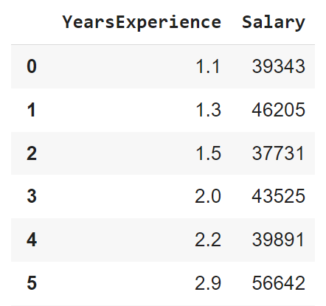
A basic example of linear regression in python

Slide 83
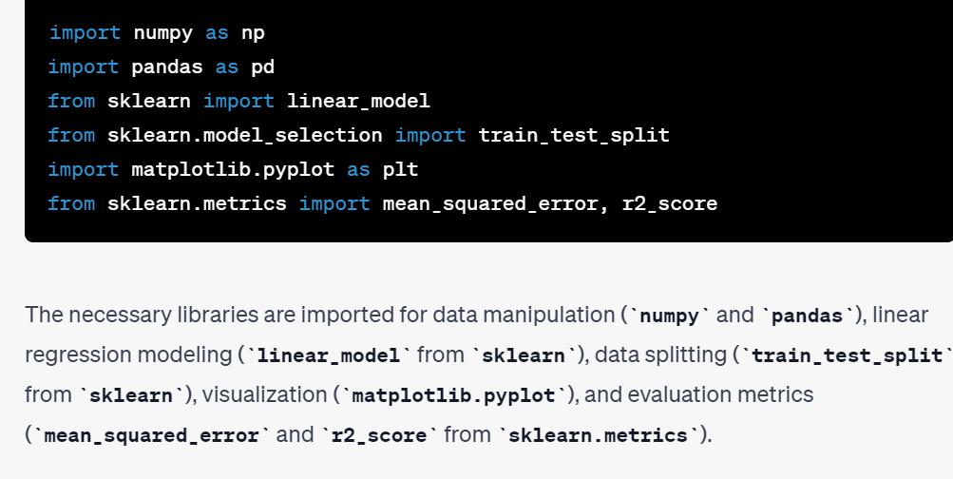
Importing the necessary lib

Slide 84
The data is loaded into a pandas DataFrame with two columns: 'YearsExperience' and 'Salary'.
df = pd.DataFrame({'YearsExperience': [...], 'Salary': [...]})
df=pd.read_csv(‘dataset name.csv’)

Slide 85
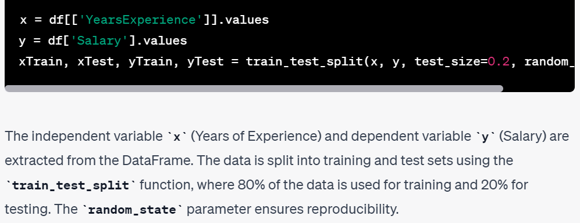
Split the Data into Training and Test Sets:

Slide 86
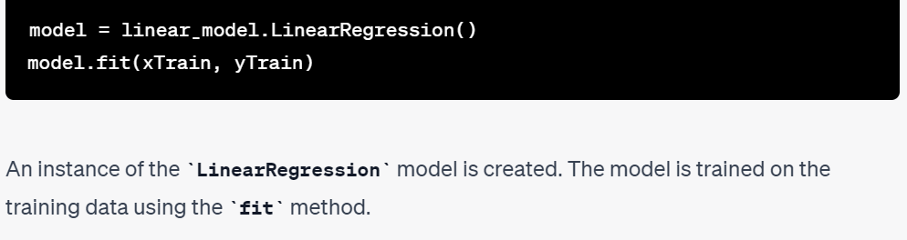
Create and Fit the Linear Regression Model:

Slide 87
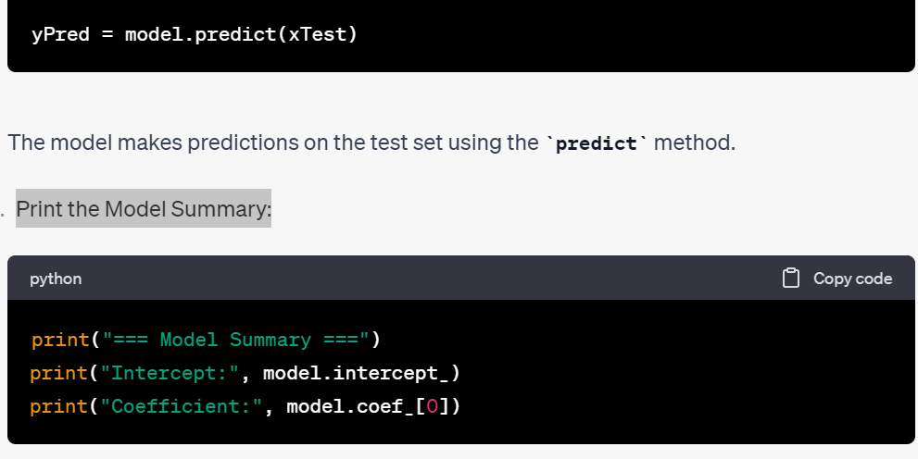
Make Predictions on the Test Set: Print the Model Summary:

Slide 88
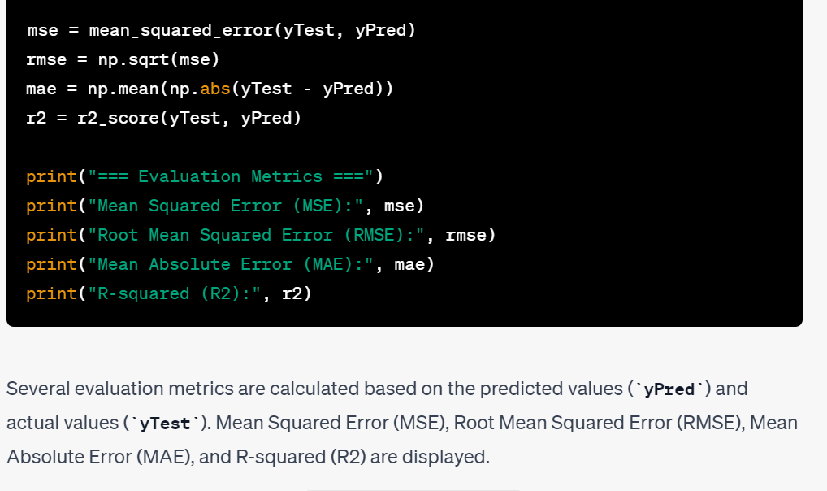
Calculate and Display Evaluation Metrics:

Slide 89
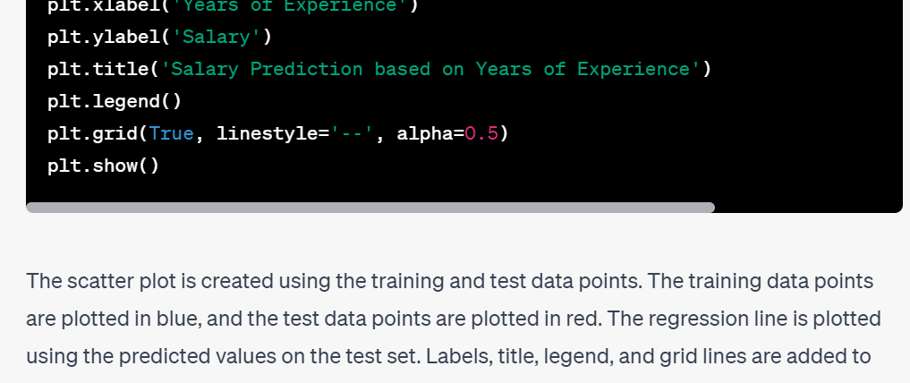
Plot the Scatter Plot and Regression Line

Slide 90
Results from the above code
=== Model Summary ===
Intercept: 25321.583011776813
Coefficient: 9423.815323030976
=== Evaluation Metrics ===
Mean Squared Error (MSE): 49830096.85590839 Root Mean Squared Error (RMSE): 7059.04362190151 Mean Absolute Error (MAE): 6286.453830757749
R-squared (R2): 0.9024461774180497

Slide 91
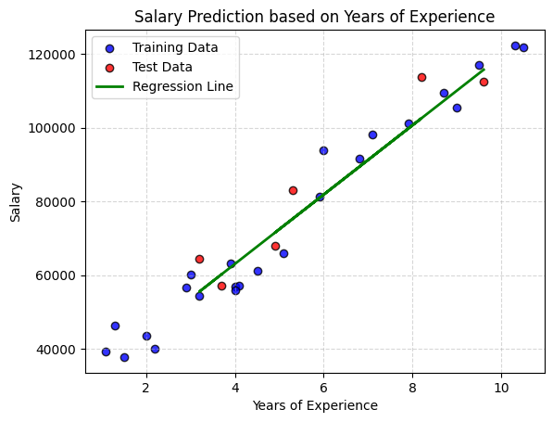
Result of using scatter Plot

Slide 92
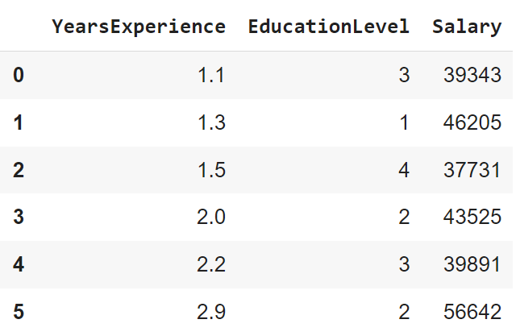
A basic example for multiple regression using Python

Slide 93
Importing the necessary lib

Slide 94
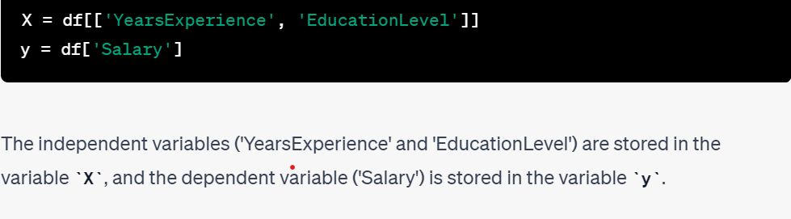
Split the Data into Independent and Dependent Variables

Slide 95
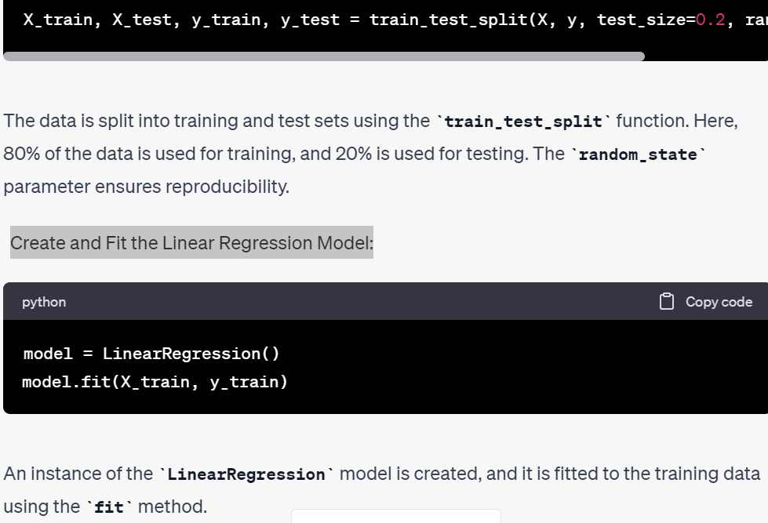
Split the Data into Training and Test Sets: Create and Fit the Linear Regression Model:

Slide 96
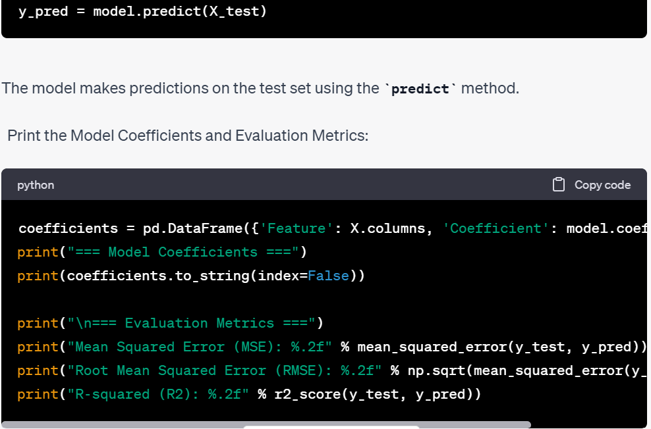
Make Predictions on the Test Set: Print the Model Coefficients and Evaluation Metrics:

Slide 97
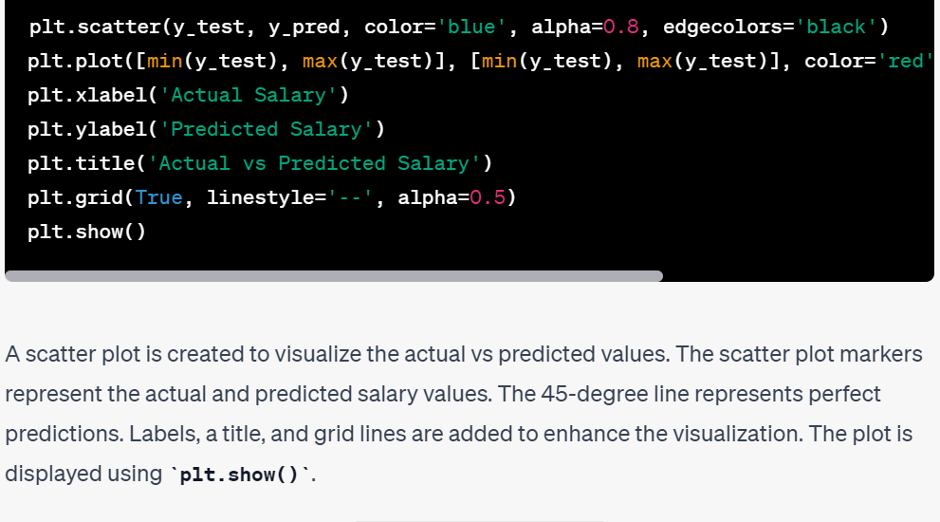
Visualize the Actual vs Predicted Values:

Slide 98
Results from the above code
=== Model Coefficients ===
Feature Coefficient
YearsExperience 9398.878807
EducationLevel -1219.143193
=== Evaluation Metrics ===
Mean Squared Error (MSE): 46471865.40
Root Mean Squared Error (RMSE): 6817.03
R-squared (R2): 0.91

Slide 99
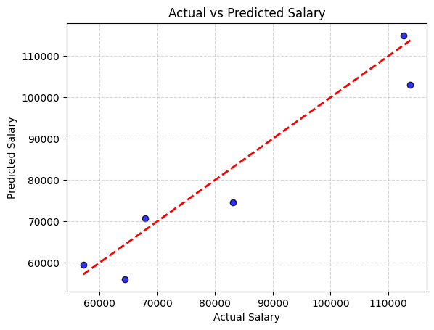
Result of using scatter Plot

Slide 100


